Slide 1
PyTorch勉強会
PyTorch study meeting
Week-7
Mitarai Lab
2021/11/24
梁 少基

Slide 2
Contents
What is RNN
What is LSTM
Forecast stock price through LSTM (Application)

Slide 3
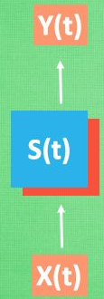
Review 復習(Chapter4)
Convolutional Neural Network :CNN 畳み込みニューラルネットワーク
The information of the feature and position of the object was able to be learnt.物体の特徴と位置という情報を学習できた。
Model
Restrictions point 使用できない場合
Time series is important.
Text data テキストデータ
Time series data タイミングデータ
Audio data オーディオデータ
Unidirectional transmission
Example
The output we need is related not only to the current input, but also to the previous input.
No ability to remember data

Slide 4
Example
When we want to predict a text data.
“Clouds are floating in the sky
Unable to memorize data patterns.
(CNN)
A pattern that can remember data.
(RNN)
（———） are. ???
（———） are. ???
（———） floating. ????
（———） floating. ????
If it can remember
（———） in. ????
（———） in. ????
contrast
（———） the . ??
（———） the . ??
（———） the sky.??
（———） the sky.??
（———） are floating in the sky ”.
Unable to predict accurately or unpredictably
ⅹ
Clouds，balloon，aircraft etc .
able to predict accurately
√

Slide 5
Contents
What is RNN
What is LSTM
Forecast stock price through LSTM (Application)

Slide 6
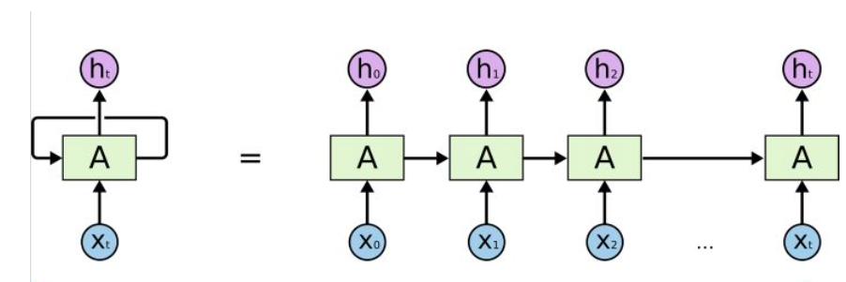
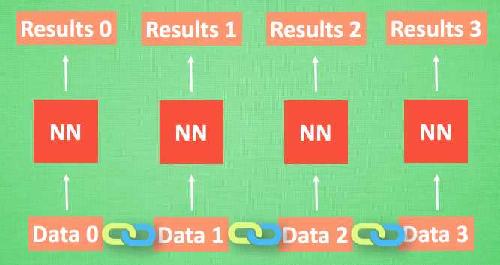
Recurrent Neural Network :RNN 再帰型ニューラルネットワーク
What is RNN?
Definition 定義
RNN is a model that can reflect time information by learning time dependence from time series data.
RNNは時系列データから時間依存性を学習することで時間情報を反映できるようにしたモデルです。
Memory and association of data
Model diagram

Slide 7
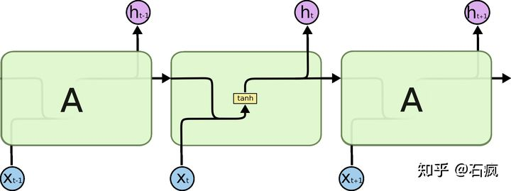
Recurrent Neural Network :RNN 再帰型ニューラルネットワーク
In RNN model, with the increase of time, the previous input has less and less influence on the final output, so it is not suitable for the prediction of long-time information.
For example
“I grew up in France... ……..I speak fluent (?)” unpredictably

Slide 8
Contents
What is RNN
What is LSTM
Forecast stock price through LSTM (Application)

Slide 9
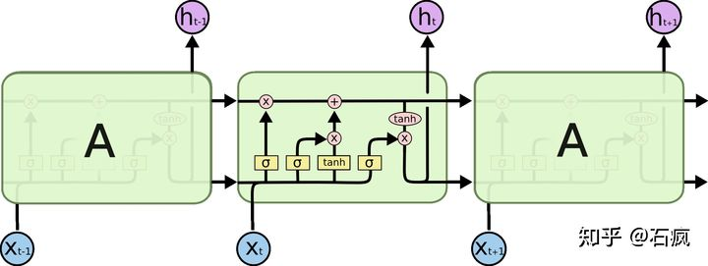

Long Short-Term Memory :LSTM
What is LSTM?
Simple to understand, In short, we can understand it as a more complex RNN model.
Cell
copy

Slide 10
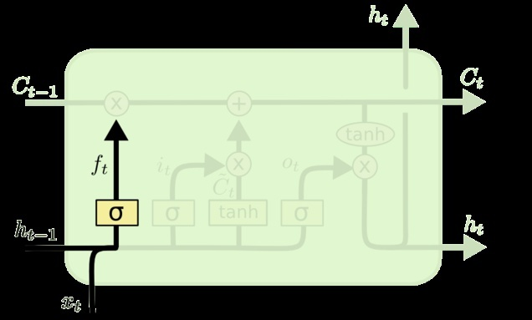
Long Short-Term Memory :LSTM (detailed)
STEP1
Main Line
The key to LSTM is the upper information line C.
There are only a few linear operations on this line, the information can be easily maintained.

Slide 11
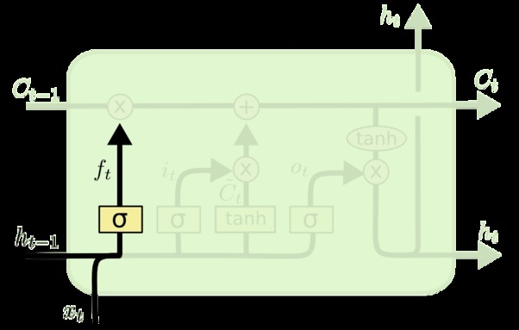

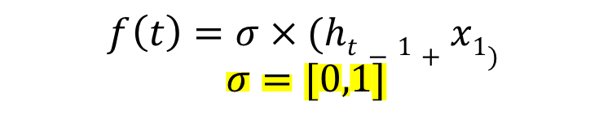
Long Short-Term Memory :LSTM (detailed)
STEP2
Forget Layer
Decide what information is forgotten
Previous output: h_{t-1}
Current input: x₁
combination
$$ht−1+x1$$
forget
$$f\left(t\right)=σ×(ht−1+x1)$$
$$σ=[0,1]$$
Proportion of forgetting

Slide 12
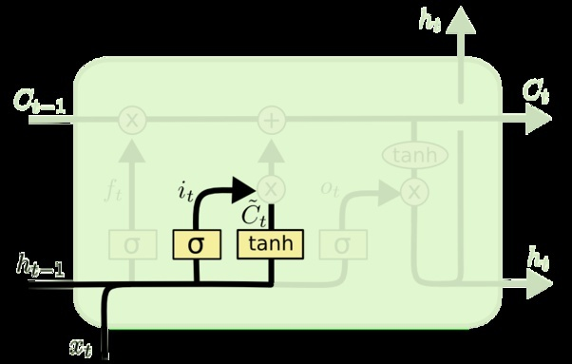
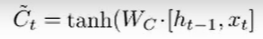

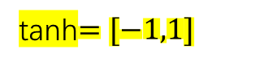
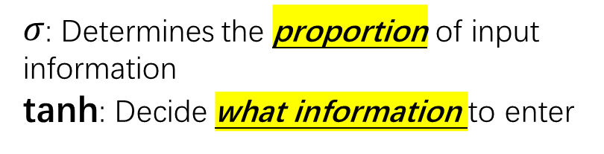

Long Short-Term Memory :LSTM (detailed)
STEP3
Data Input
Layer
Decide what information is entered
Previous output: h_{t-1}
Current input: x₁
combination
$$ht−1+x1$$
retain
$$i\left(t\right)=σ×(ht−1+x1)$$
$$σ=0\sim 1$$
tanh$=[−1,1]$
$σ$: Determines the proportion of input information
tanh: Decide what information to enter

Slide 13
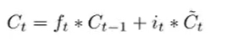
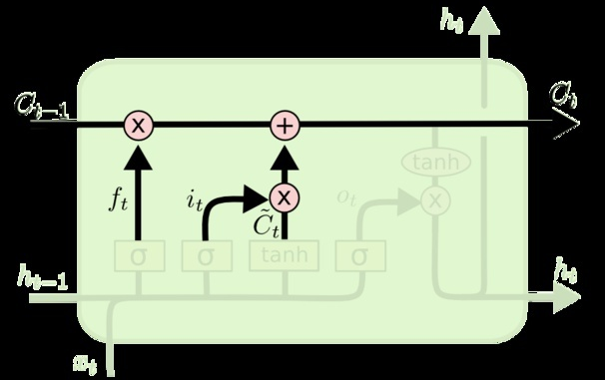
Long Short-Term Memory :LSTM (detailed)
STEP4
Update data Layer
Update new information unit
Forgotten part
Newly input part
Compose new(now) information
C_{t}

Slide 14
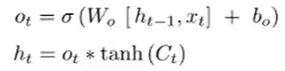
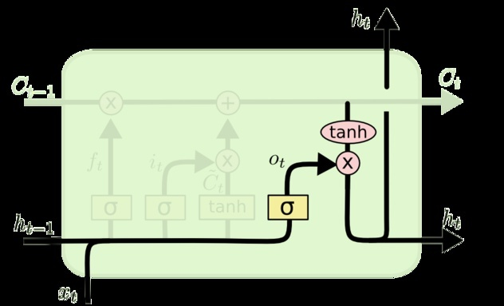
Long Short-Term Memory :LSTM (detailed)
STEP4
Output Data Layer
Decide what information to output
Output the results of the current time and hiddent state ( h _{t})
Cell state

Slide 15
Example
Time 1
Output
“I wanted to eat apples yesterday”.
STEP3
Data Input
Layer
STEP2
Forget Layer
remember
forget
Time 2
Input
“I wanted to eat bananas today”.
STEP3
Data Input
Layer
Input
Time 2
Output
“I wanted to eat bananas today.”

Slide 16
Long Short-Term Memory :LSTM
Operations and learning that can be performed by LSTM (P143)
Can keep the previous information very early.
Forget unnecessary or duplicate information
Keep the error and prevent the proportion from disappearing.

Slide 17
Contents
What is RNN
What is LSTM
Forecast stock price through LSTM (Application)

Slide 18
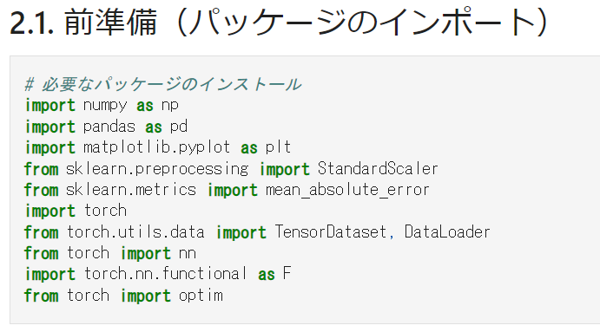
Forecast stock price through LSTM
STEP1

Slide 19
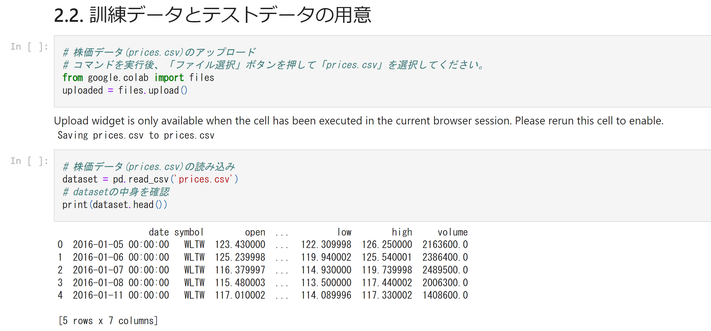
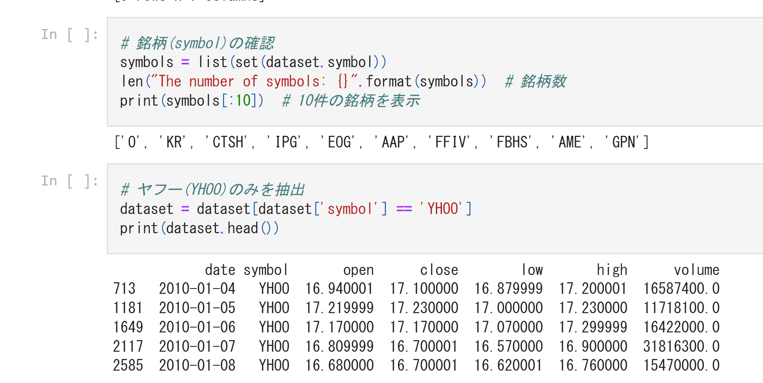
Preparation of training data and test data (P146)
Pick out Yahoo's stock price data

Slide 20
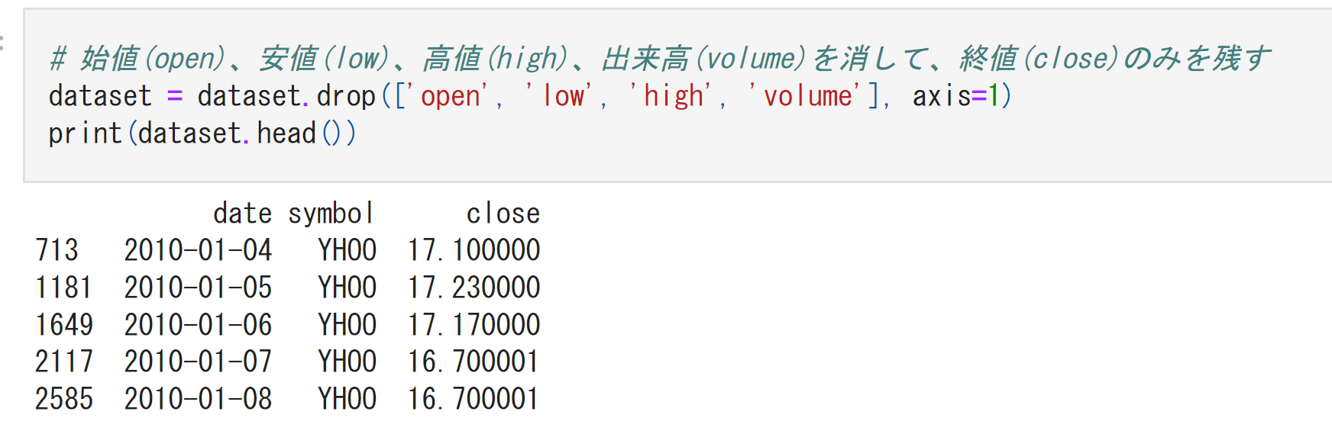
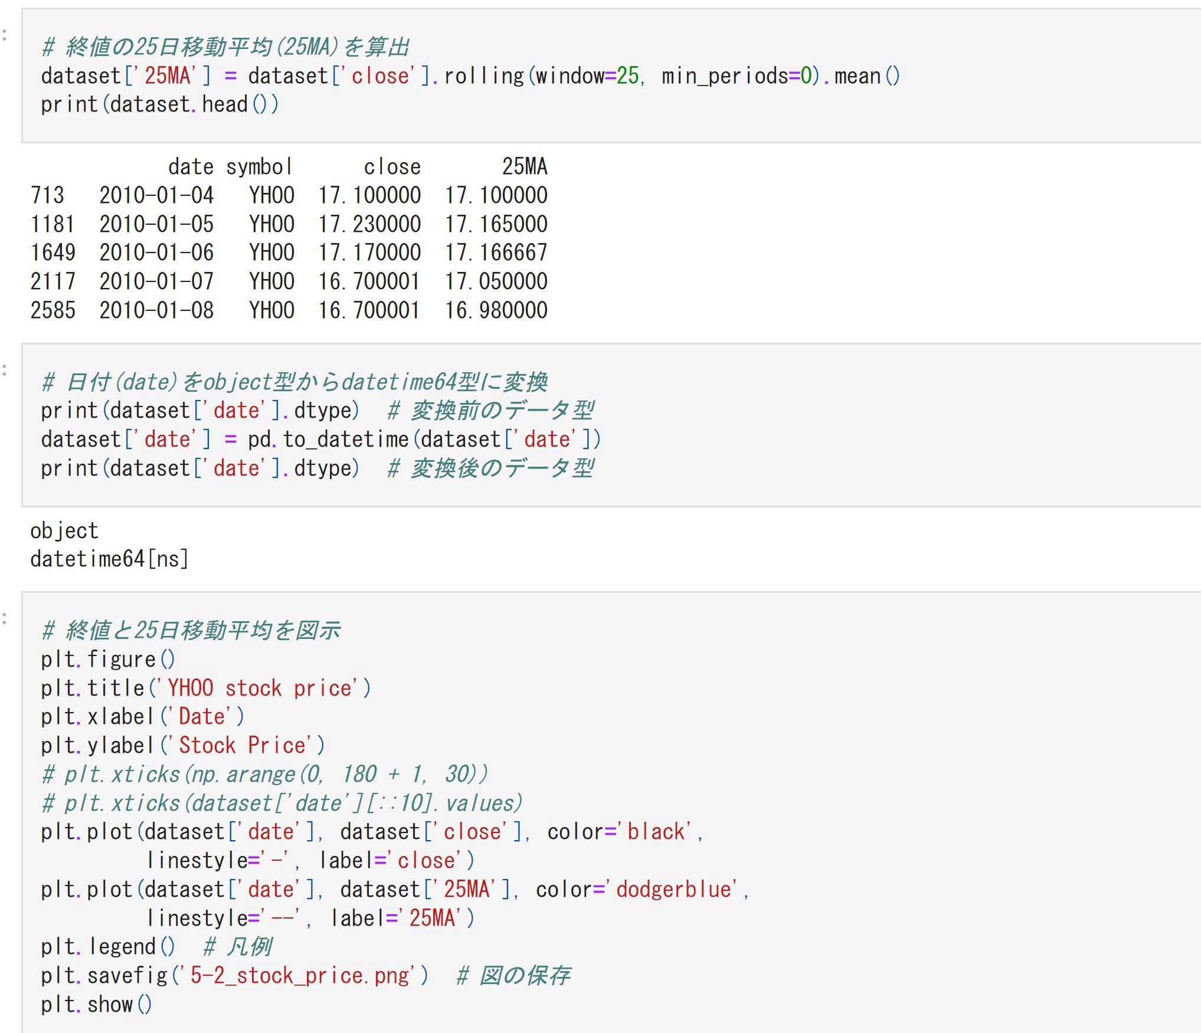
1. Filter out the required data
2. Calculate the 25 day average from the data obtained
3. Transformation of data type

Slide 21
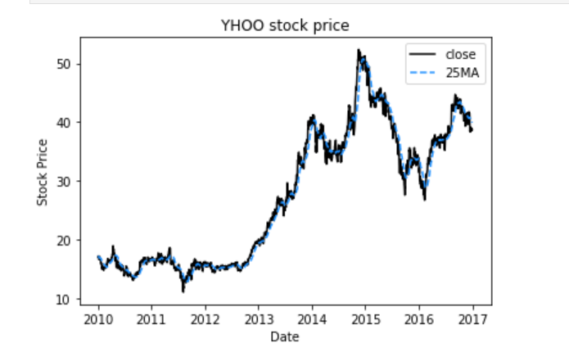
4. Export stock price graph

Slide 22
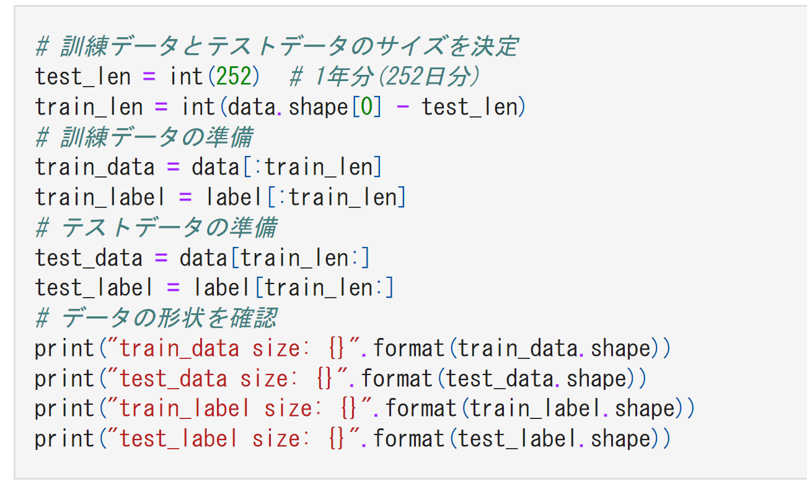
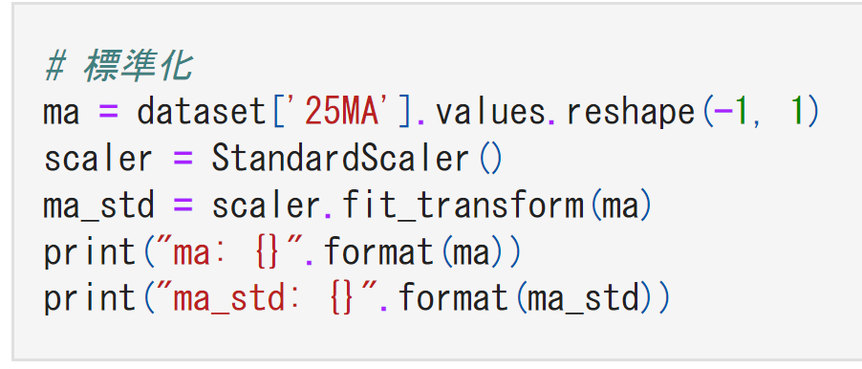
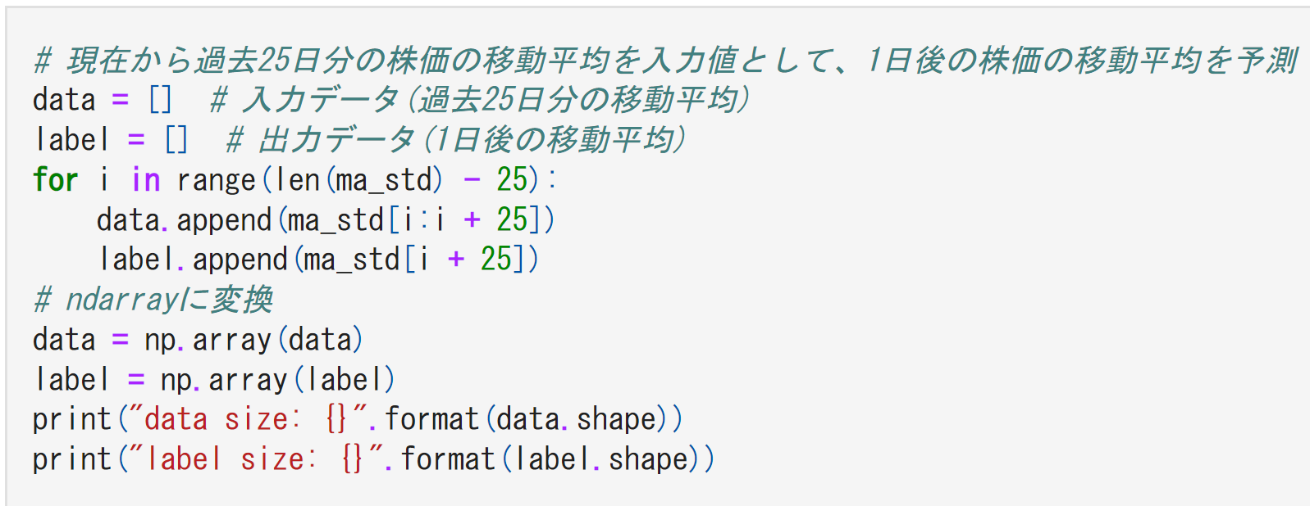
Data standardization
Forecast the average change of the next day
The stock price data is divided into training data and test data

Slide 23
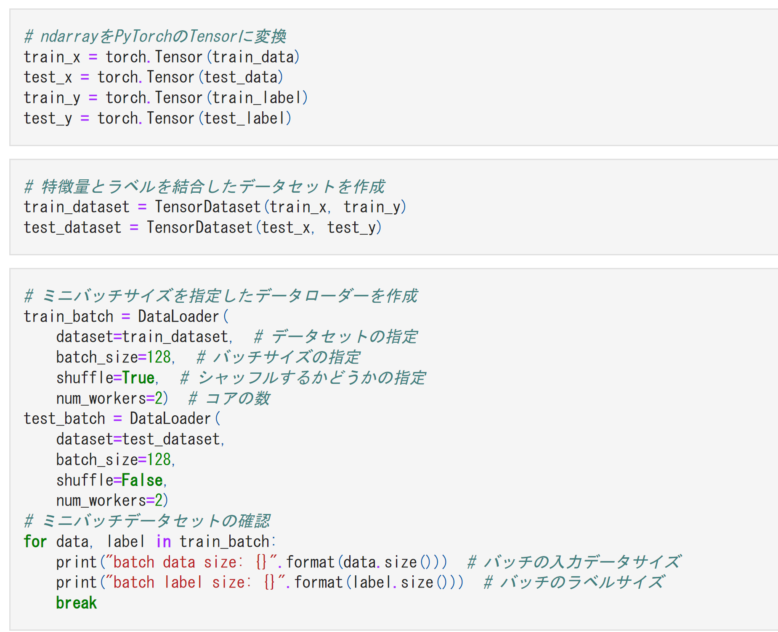
Change the type of training data and test data to tensor type
Set data characteristics and labels

Slide 24
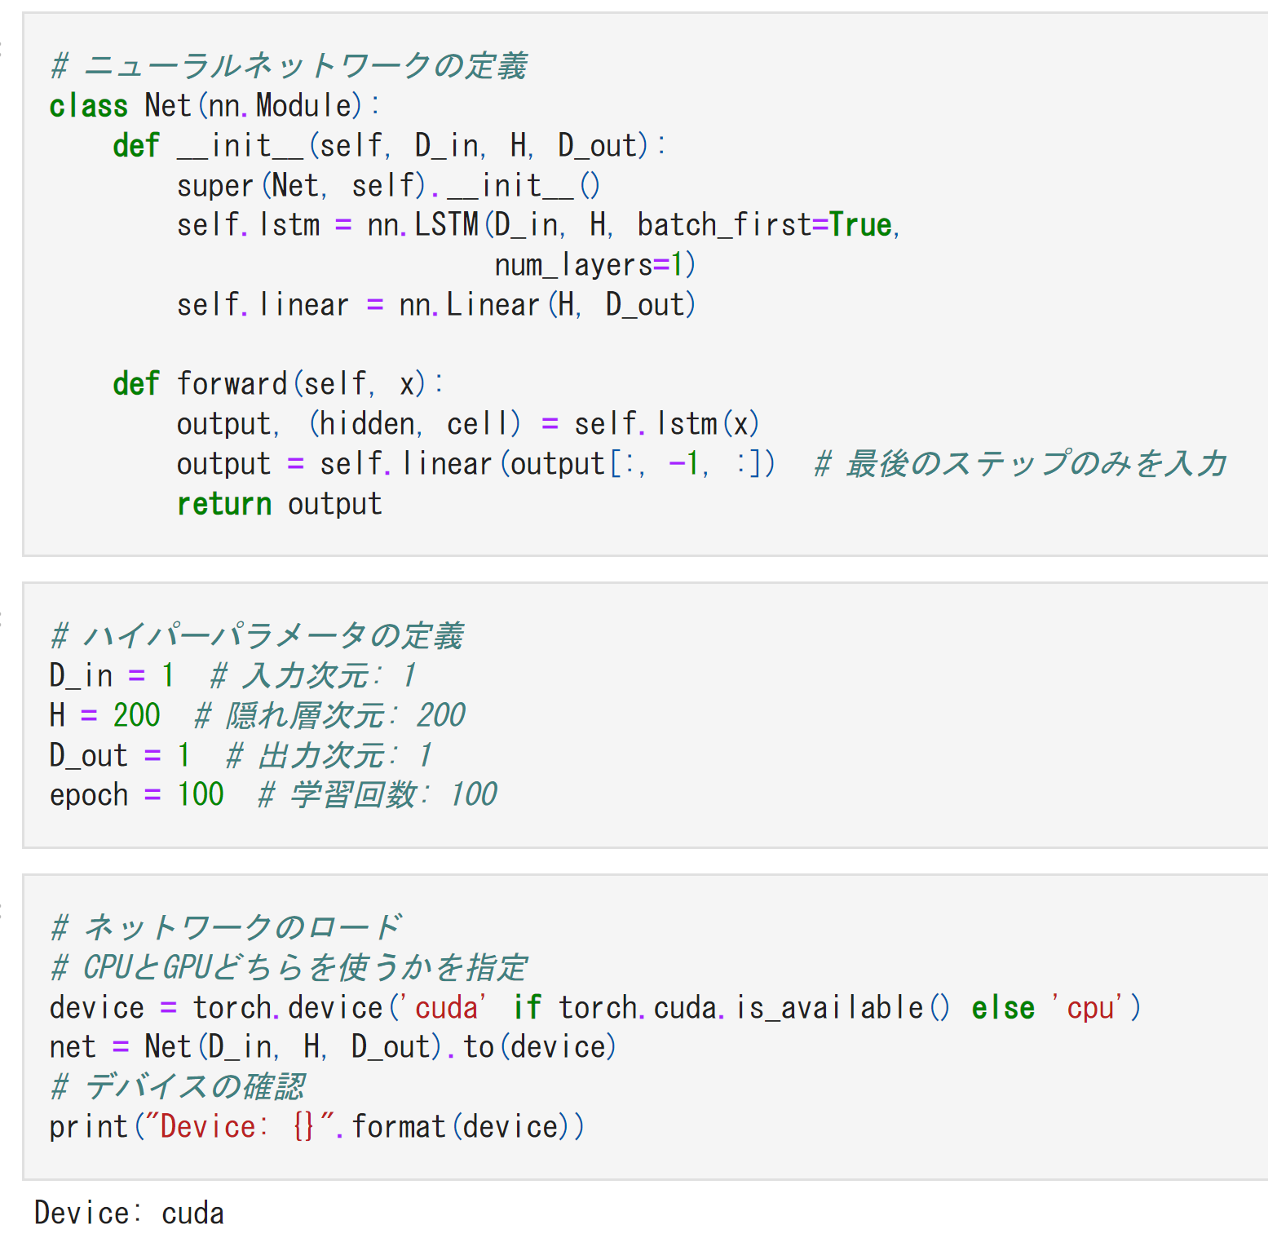
2.3. ニューラルネットワークの定義
Defining LSTM data type
Set the hyperparameters of the neural network
Run the following command to load the defined neural network

Slide 25
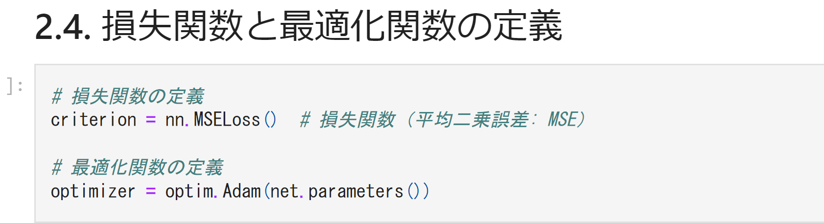
2.4 Definition of loss function and optimization
The mean squared error loss MSE nn.MSELoss is be used .

Slide 26
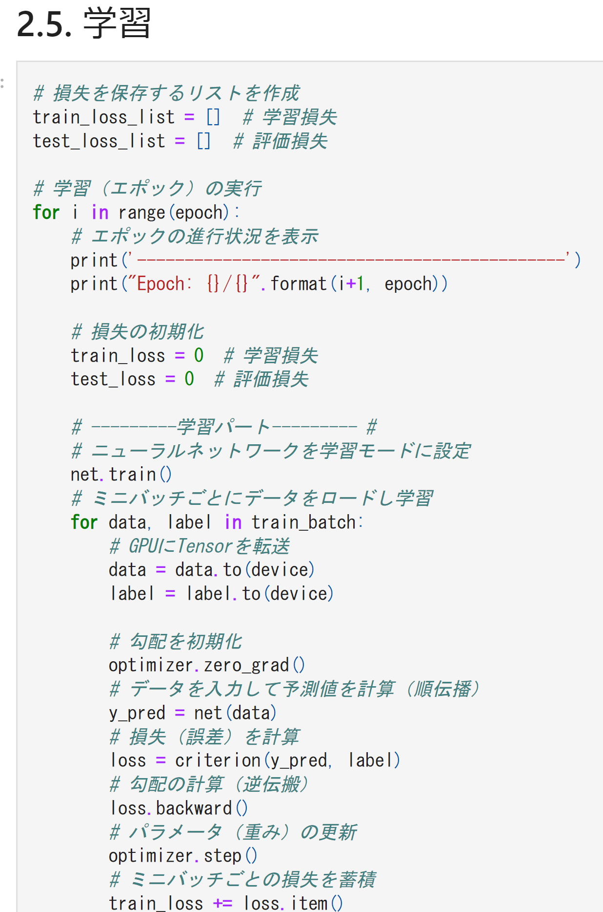
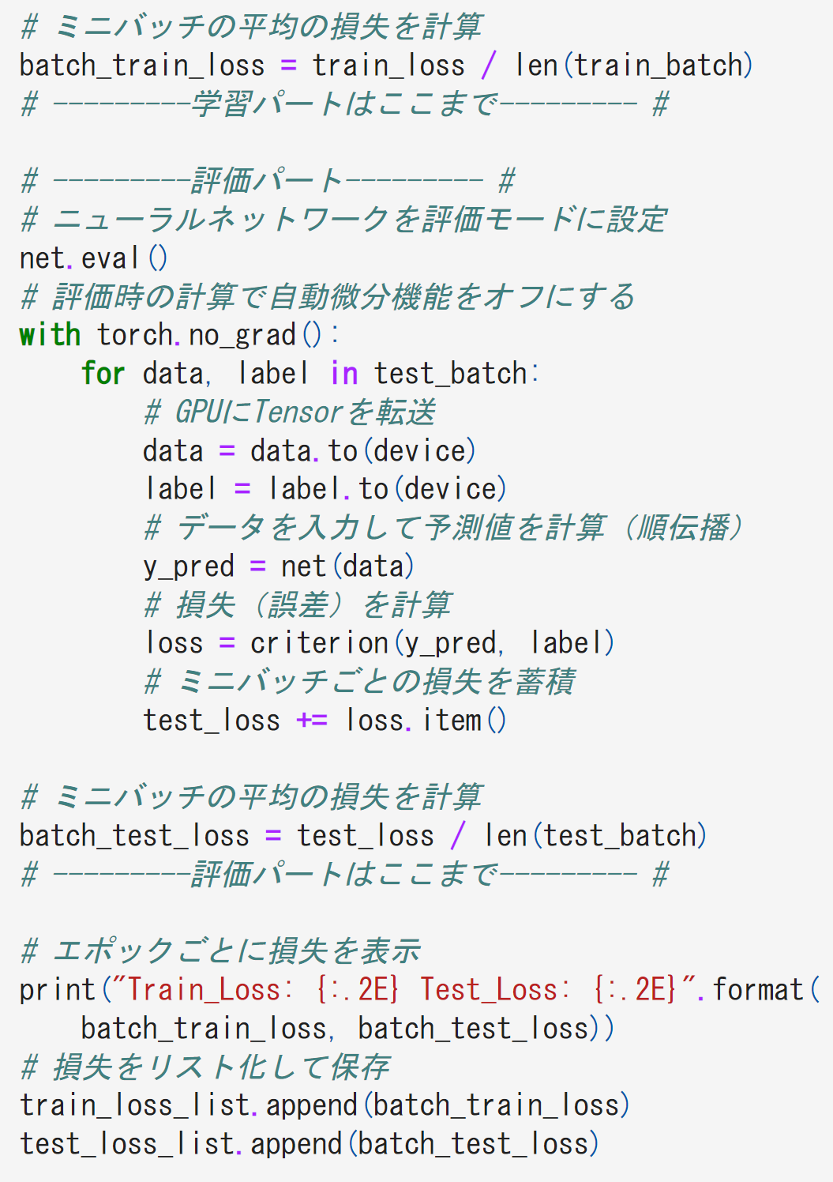
2.5 Learning

Slide 27
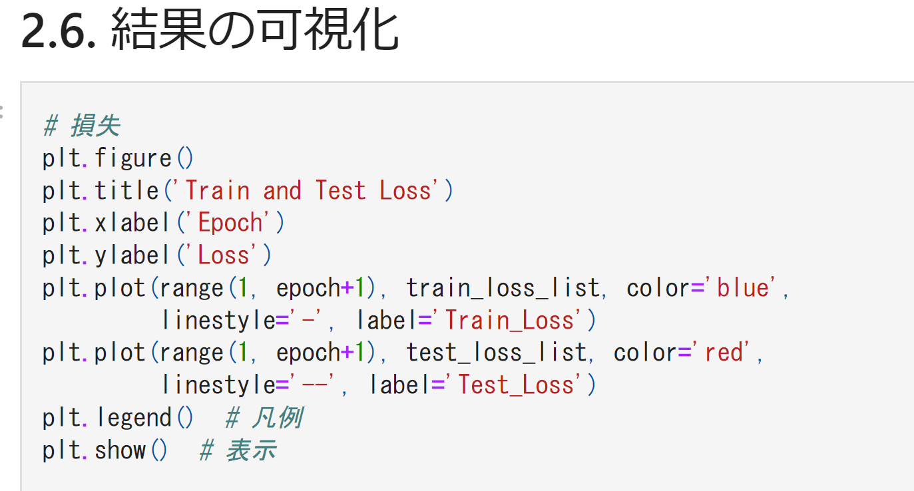
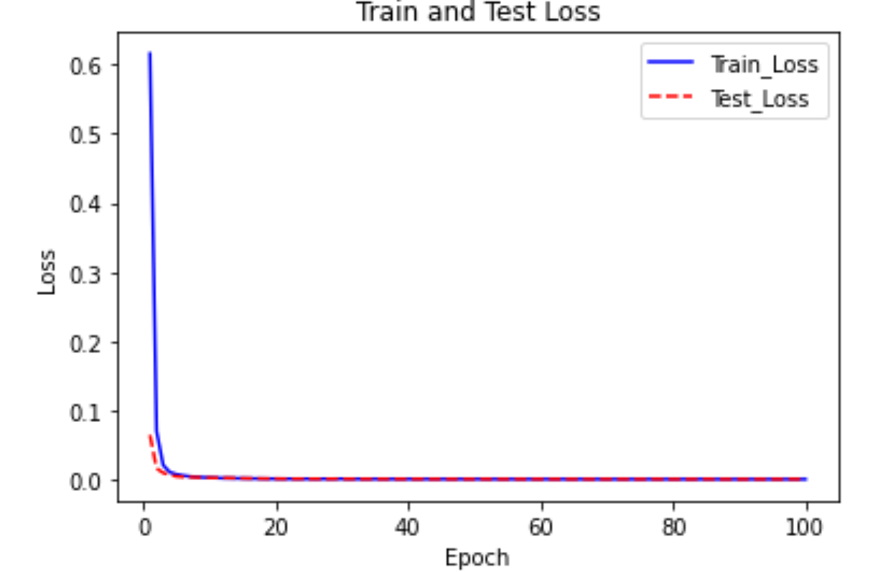
2.6 Visualization of results
The learning is over ,let’s visualize the results .

Slide 28
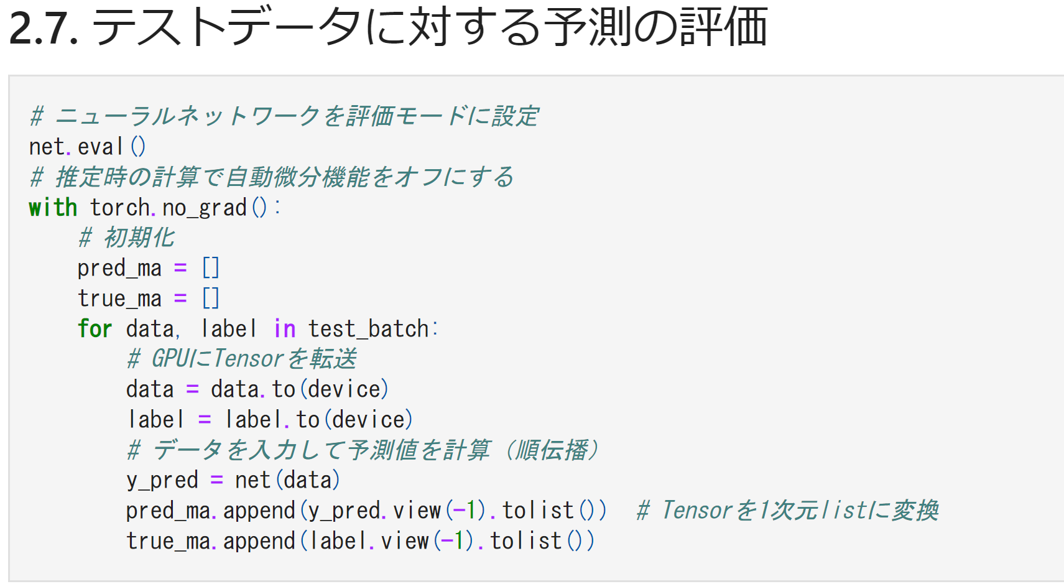
2.7 Evaluation of predictions for test data (Confirm accuracy )
The learning is over ,let’s visualize the results .

Slide 29
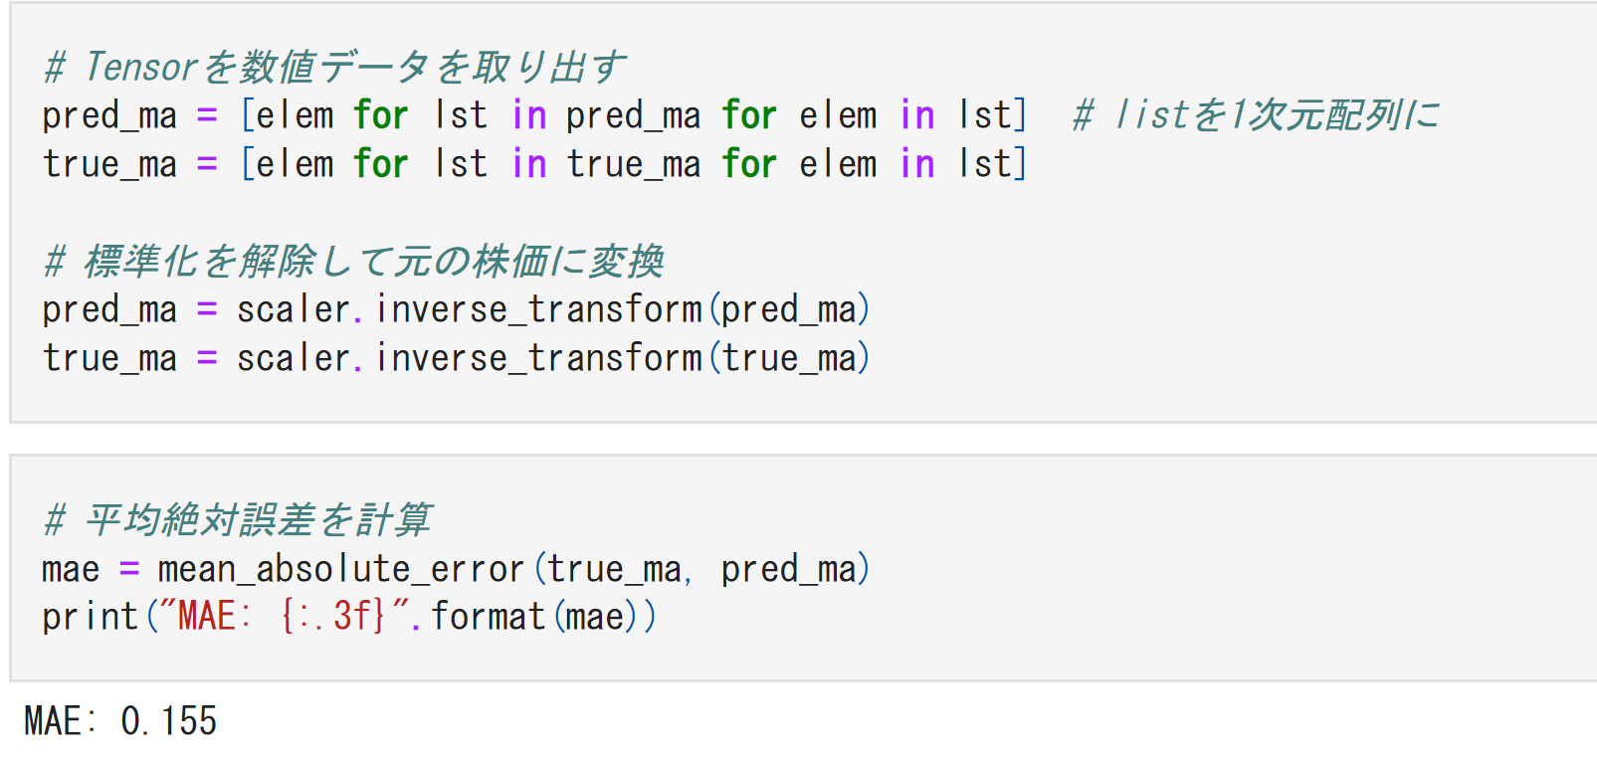
Take out the tensor in the form of numerical data
Turn standardized data into stock price data
Calculation of average error

Slide 30
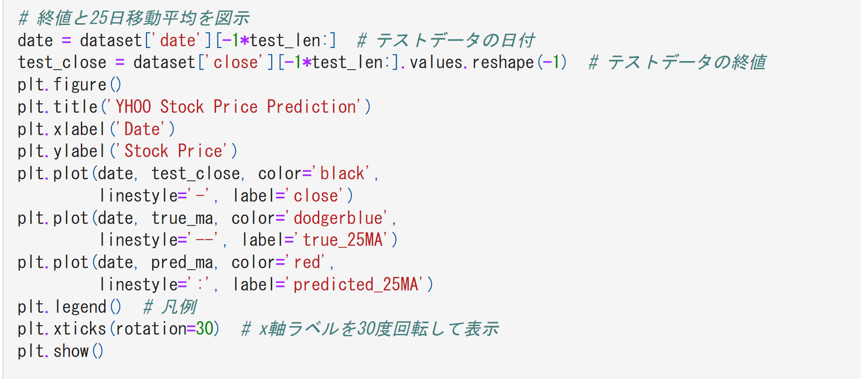
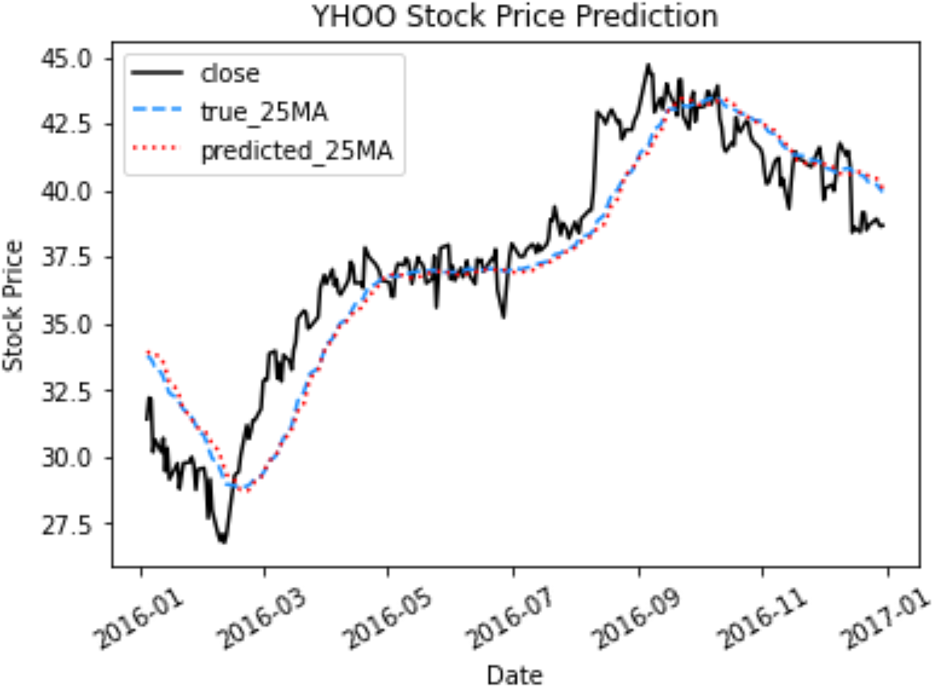
The predicted polt based on close data and ture-25Ma is derived

